Slide 1
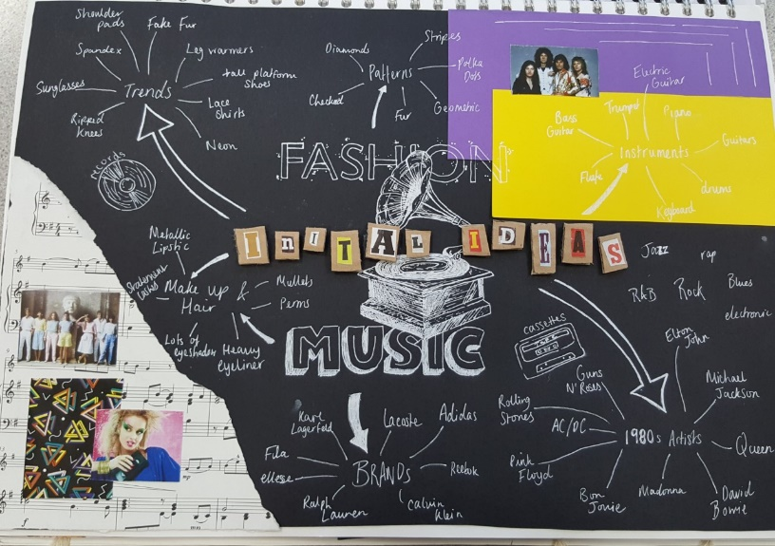
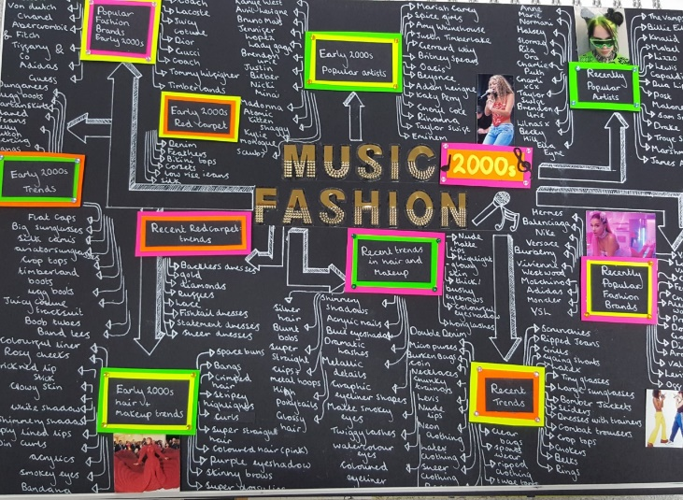
Yr 11 - Summer tasks for Textile Design, fine Art and Graphics A’ Level courses
Project title: Nostalgia
Task 1 – Choose a decade from the 1940’s – 1990’s
Create an A3 creative mind map for your chosen decade exploring all visual options. Such as fashion, colours, lettering, shapes, patterns, textiles, surfaces, objects, music and musicians, Album covers, films, literature, famous people, key events and moments in history, art movements etc. This will be presented in your A3 sketchbook.
Although the examples to the right are for a different theme: You should be able to take inspiration from them in terms of detail and creative presentation and our expectations.

Slide 2
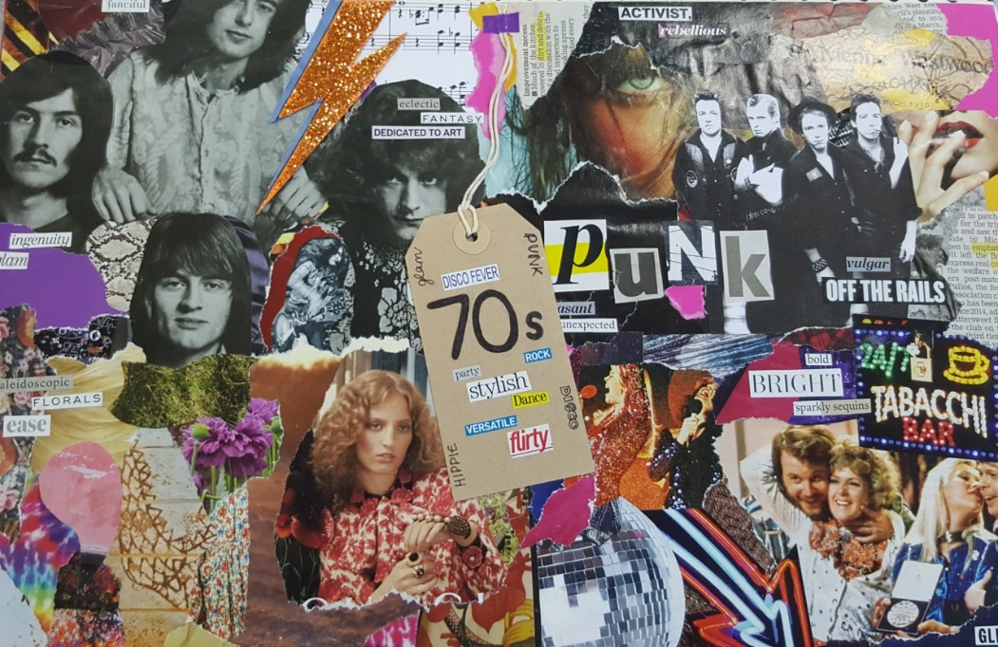
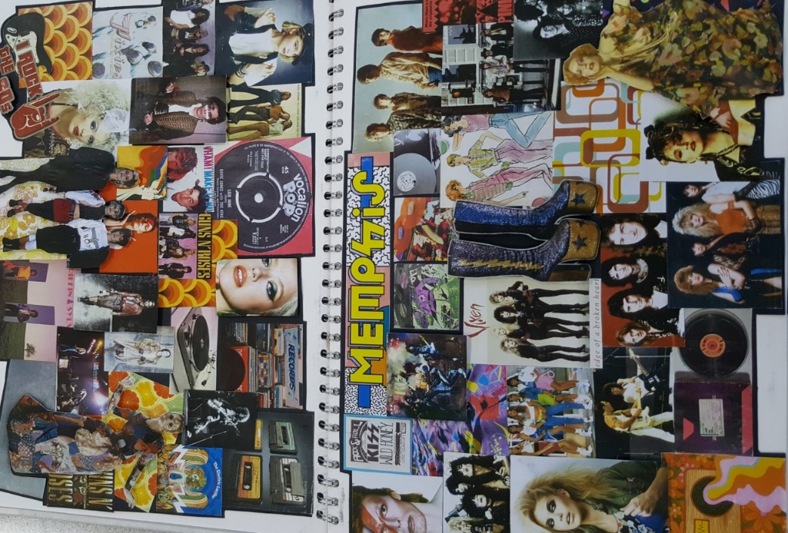
Task 2 - You are to use the internet/ magazines or source other materials for your decade to create two A3 mood pages which will be presented in your A3 sketchbook.
Use your ideas explored as part of your mind map. These should be presented creatively on two A3 sized pieces of paper. Your mood pages should create a strong link to your decade without any need for annotation.
Your pages can be made up of imagery, fabric, papers, colour swatches, accessories linked with your theme be really creative!!! Show your understanding with appropriate images, text, patterns colour schemes which you can use to inspire your own work
Although the examples below are for a different theme: You can take inspiration from them in terms of impact, style, creative presentation and our expectations.

Slide 3
Visits to Art Galleries and Exhibitions
If you could visit an art gallery or exhibition this is a significant aspect of understanding art at A level. Try and find one art work, sculpture artefacts, graphics, illustrations or costumes that are relevant to your chosen decade.
Tate Gallery Liverpool,
Walker Art Gallery Liverpool
British Music Experience Liverpool
V and A Diva exhibition London
Fine Art
Francoise Nielly
Jenny Armitage
Mark Powell
Derek Gores
Audrey Flack
Textile Design
A designer significant of your decade Chanel. Christian Dior, Mary Quant, Vivienne Westwood
Jennifer Collier
Graphics
Michael Craig Martin
Fionne Fernandes
Malika Favre
Patrick Boyer
Task Artist analysis
Find research and watch any relevant youtube videos about one of these artists/designers relating to your specialism
Write in depth about one of these artists which is appropriate to your specialism. Write about the style and composition, ideas behind their work, use of colour and techniques
Hand in first lesson back in September

Slide 4
A level Expectations
All students will be introduced to the course structure and given guidelines of expectations and conduct on the course.
You should be aware of the high expectations when using facilities and equipment especially cleaning, tidying and putting equipment back.
You should understand and work to health and safety issues in the department and when using the art studio.
Only art students can use the art studio.
You should bring in your sketchbook to every lesson and any current work. Any previous work should be kept in your allocated drawer.
You should try to meet deadlines as they are in place to aid organisation, monitor your work, review, evaluate and assess your progress.
Basic Equipment List
A3 sketchbook – Portrait can be sourced by you
Watercolours
Acrylic paints (Textile Design and Fine Art students)
A selection of small paint brushes
Drawing and shading pencils
A good selection of fine liners and coloured pencils
Ruler, rubbers, pencil sharpener
Other desirables
Posca Pens
Gold, silver or white fine liner to write with in sketchbook
Textile Design: fabric scissors, own pins, Collecting fabrics, threads, embellishments, trimmings, beads which may be appropriate for your nostalgic decade.

