Slide 1
Welcome to
Year 12
Information Evening
20th September 2023

Slide 2
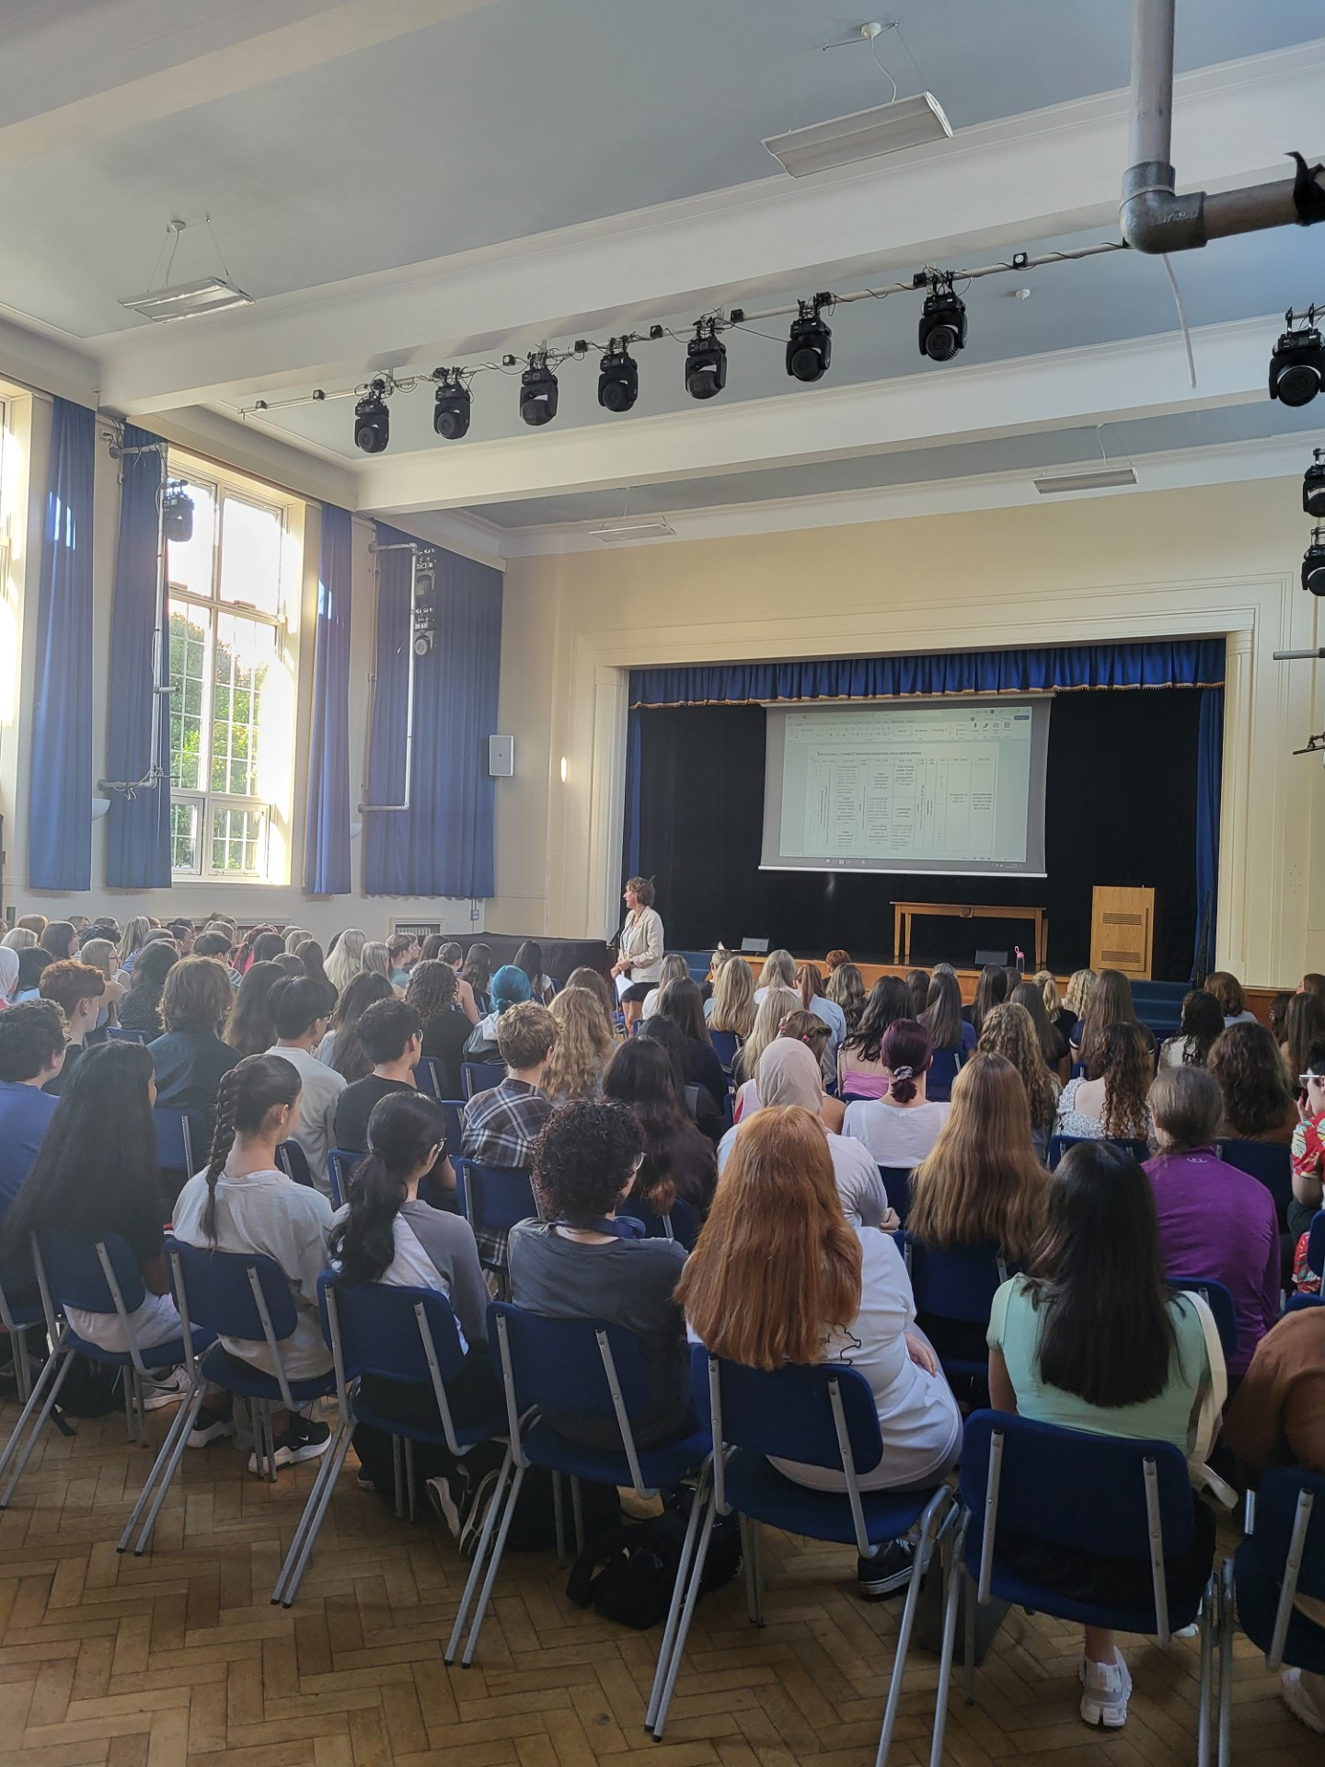
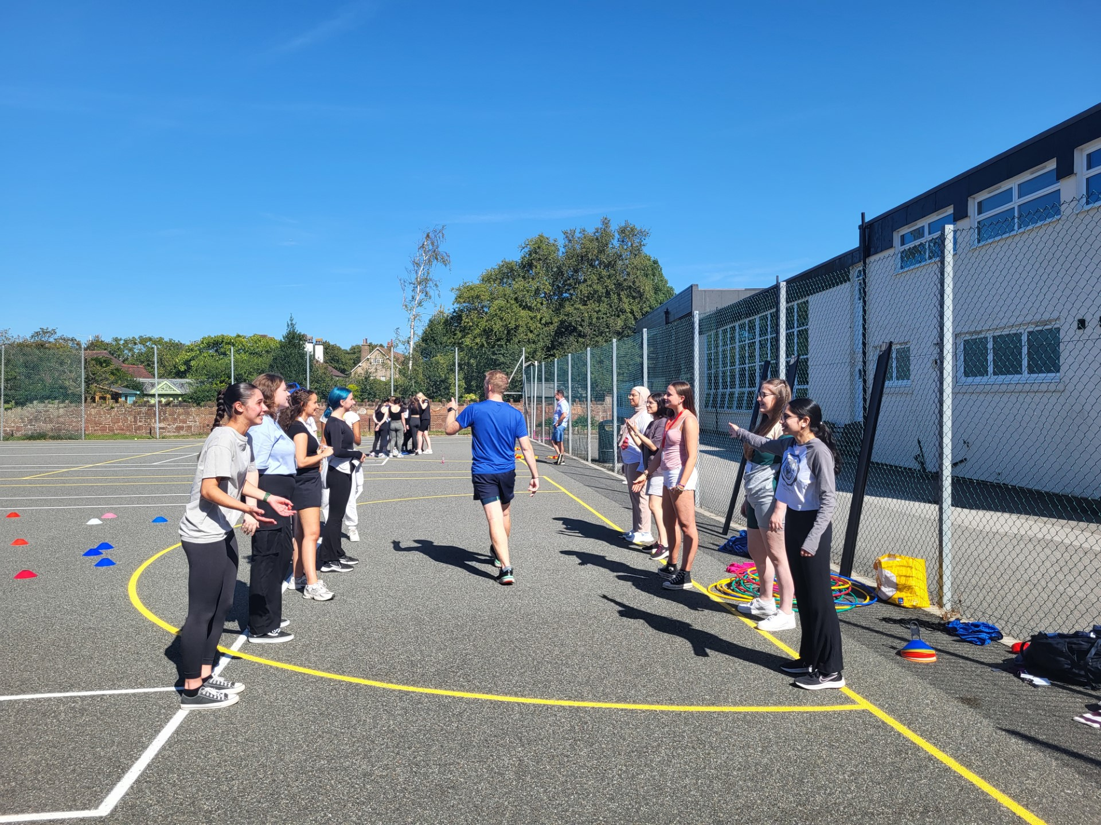
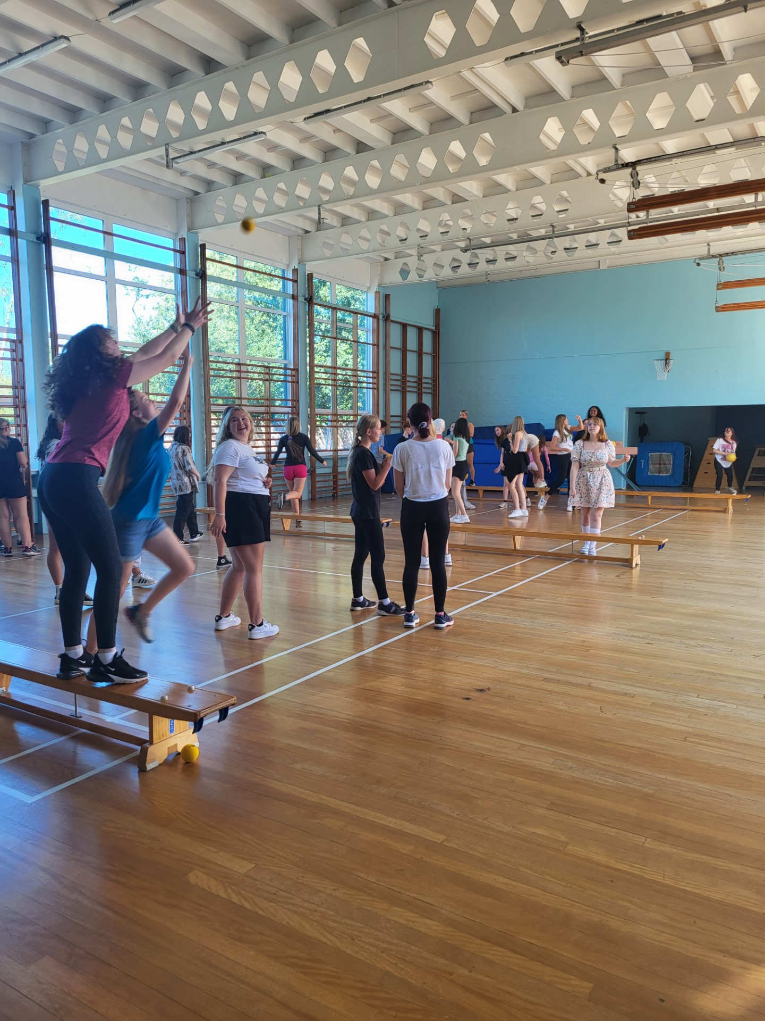
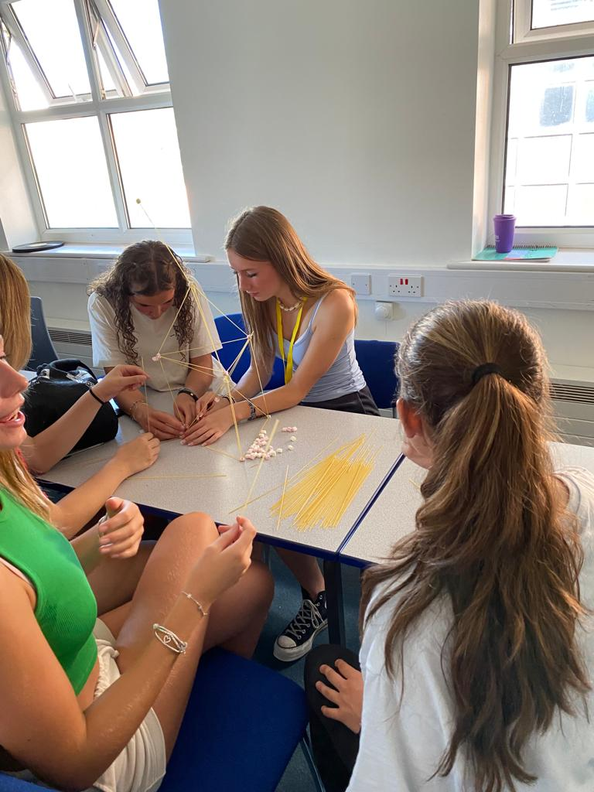
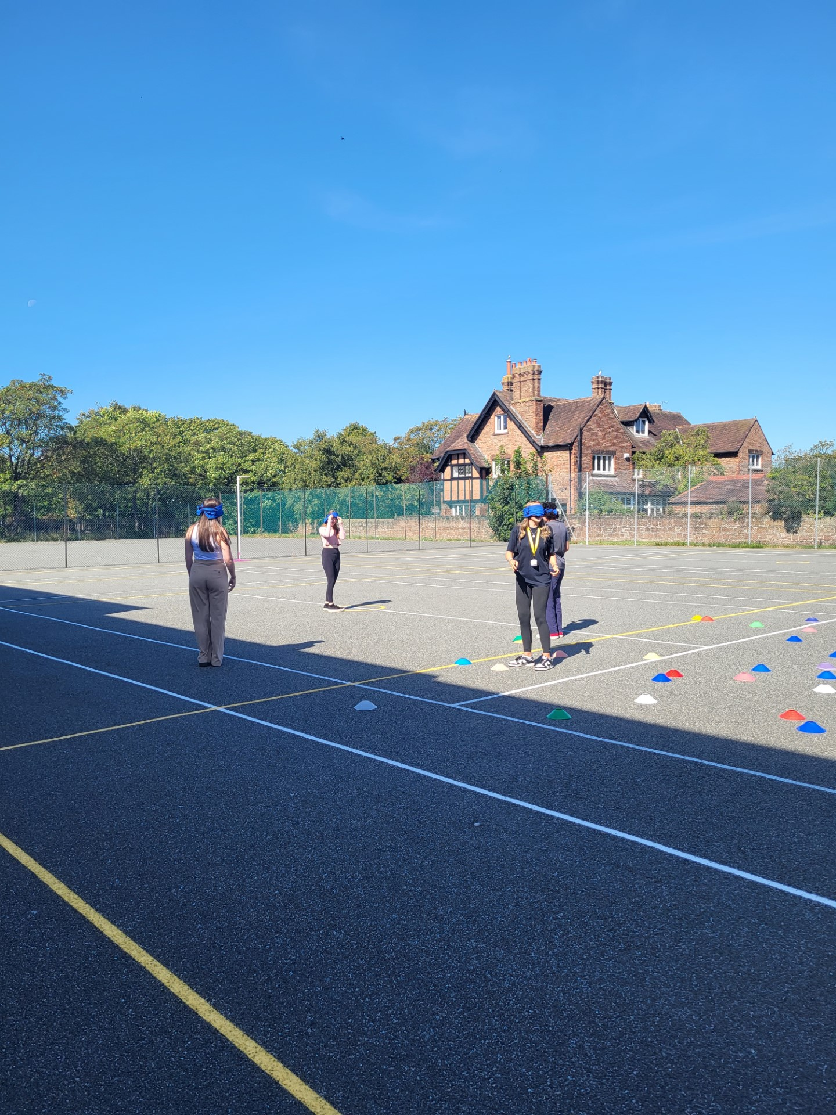
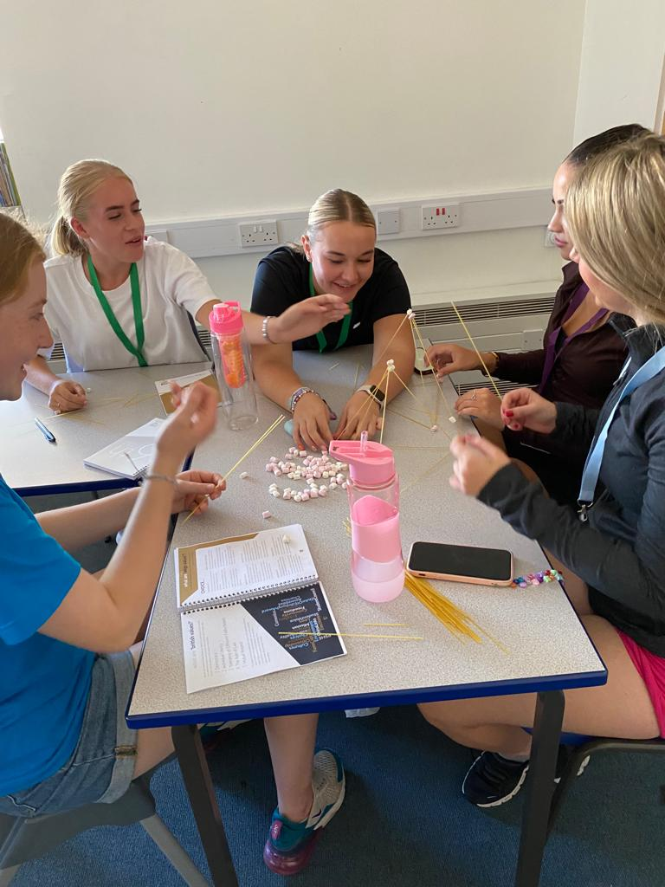
Induction day
Notes:
Friday 2nd September was our first induction day. We have introduced our expectations and outlined the plan for the rest of the year.
We had a talk about study skills and enhancing experience and applications
Teambuilding and communication skills.

Slide 3
Expectations
Uniform
Attendance
Punctuality
Respect
Role models
Work ethic
Notes:
As a result of our aim to develop the individual, we must have HIGH expectations and these are:

Slide 4
Sixth Form Dress Code
Not Appropriate for School
Hoodies
Jeans
Shorts
Tracksuit bottoms
Leggings
Tight fitting or short skirts
Tops with large logos
Strappy tops
Flip flops
Trainers (or similar)/Canvas shoes
Outdoor coats and hats must not be worn inside school
Tailored Jacket
Tailored trousers or skirt (appropriate in length and worn with tights)
Tops and shirts should be smart
Leather or leather effect shoes
Lanyard
Natural hair colour

Slide 5
Absence
Expected attendance 97%
Below 95% letter sent (stage 1 – 3)
Below 90% = persistent absence
Unforeseen - PARENT must contact every day of absence
Medical – evidence required
Open days/interviews/post offer day – up to 3
Planned Absence – LOA form required

Slide 6
Punctuality
Arrival after the following times will be recorded as late:
- 8.50am Morning reg
- 1.50pm Afternoon reg
Accumulate of two or more lates in a week will result in detention

Slide 7
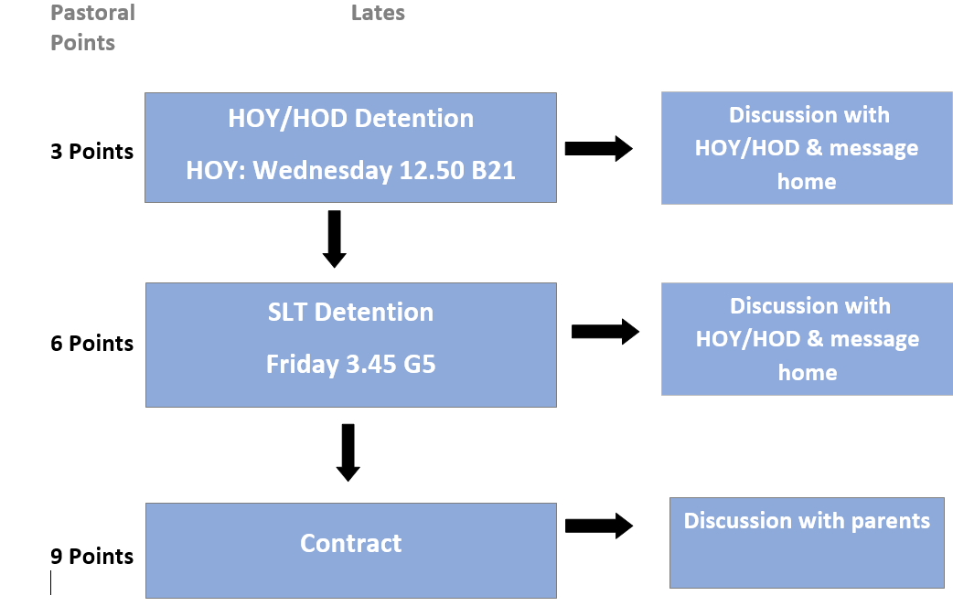
Sixth Form Conduct System

Slide 8


Work Ethic
Use of lesson time and subject staff
Attendance at support sessions
Supervised Study - not for homework
Free lessons – used wisely reduces homework time at home
Going the extra mile – super curricular
3 hours independent study per day

Slide 9

Surviving the Workload & Developing skills for the Future
Organisation
Time-management
Motivation
Independence
Study periods

Slide 10
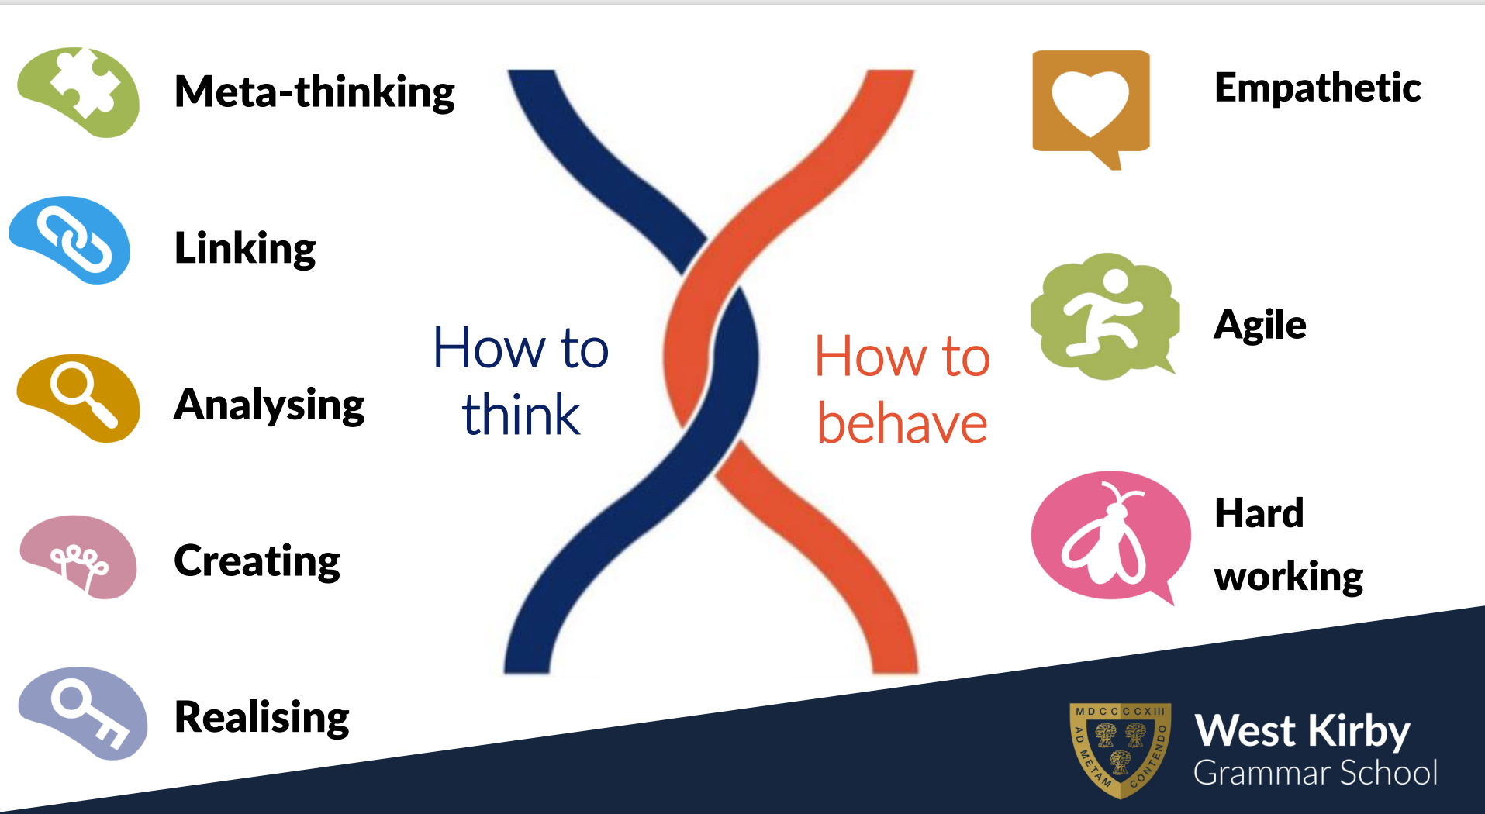

Slide 11
Curriculum
Optional Curriculum
  3/4 Subject choice
  Changing/definite drops – End September
  Choosing AS (4th subject) - start of January
The Core Curriculum
  EPQ
  Enrichment
Additional
  Study periods
  Free periods
  Personal development

Slide 12
Progress Monitoring
Transition work/ Assessment
Short report issued and action plans
AS Decisions (Christmas)
Short Report issued and action plan
Progress Evening
End of year exams (17 June)
Short report issued and action plan

Slide 13

WKGS Values - CHOICE
As well as developing skills as resilient and enterprising learners in the classroom, our focus is also on helping students explore and uncover their skills and talents, to dream big and make the most of opportunities to enrich the curriculum and contribute to the school community.

Slide 14

Opportunities
Form Representatives
Charity Representatives
Subject Mentors
Clubs & societies
Trips/workshops
House activities
Prefect Teams
House Officials
SLA

Slide 15
Form time
W/B | MONDAY | TUESDAY
4th September | INSET | INDUCTION
11th September | World Medical Ethics day | Study Skills - Vision
18th September | INSET | Study Skills - Effort
25th September | World Heart Day | Study Skills - Systems
2nd October | Black History Month | Study Skills - Practice
9th October | World Mental Health Day | Study Skills - Attitudes
16th October | Global Dignity Day | File checks/plan for half term*

Slide 16

Personal Development Days
Wednesday 18th October
Thursday 14th December
Tuesday 6th February
Monday 25th March
Wednesday 23rd May

Slide 17
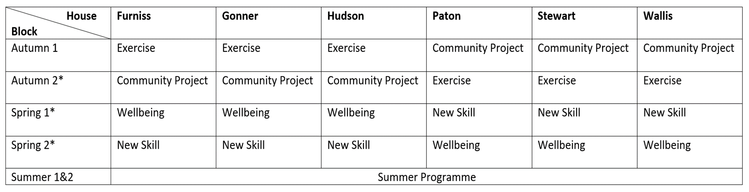

Enrichment Options

Slide 18

Extended Project Qualification (EPQ)
Provides key skills that universities and employers are interested in
Independent learning – choice of topic and format (dissertation, investigation or fieldwork, production or artefact )
Exercise use of in-depth research and critical analysis
Additional qualification with UCAS points

Slide 19
Careers Guidance
Dedicated Careers Library for Sixth Form
Careers advisor –Ruth Evans
Summer Programme
Interview preparation support
Work experience week in summer term

Slide 20
Part-time employment
We recognise the importance of employment; building skills, gaining experience, interaction with others, developing confidence and earning income.
Research nationally has shown that working up to 9 hours per week does not appear to influence examination grades
However, if employment exceeds 9 hours per week, research has shown that grades are lower for additional hours.
Social Time

Slide 21

Sixth form student support personnel
Assistant Head Teacher (Sixth Form) - Mrs L Marley
Head of Year 12 - Mrs Duffey
Head of Year 13 - Mr R Price
Pastoral Assistant - Mrs J Brown
Attendance Officer – Miss E Hughes
Administrative Assistant - Mrs S Harris-Smith
Form Tutors

Slide 22
Specialised Support
Well-Being Manager - Mrs D Lidgett
Safeguarding lead - Mrs K Leighton
SEND Co-ordinator - Miss L Stowell
Examinations Officer - Mrs D Hill-Jones

Slide 23
Financial Support
Vulnerable Student Bursary – Up to £1200
- Care leavers
  - Students in receipt of income support
  Disabled students who receive Employment Support Allowance and Personal Independence Payments (Disability Living Allowance)
Discretionary Bursary - Up to £1000 per year
Household income less than £25,000

Slide 24
Any questions?
Name | Email
Mrs L Marley, Assistant Head Teacher – Head of 6th Form | lmarley@wkgs.net
Mrs A Duffey - Head of Year 12 | aduffey@wkgs.net
Mrs J Brown – Pastoral Assistant | jbrown@wkgs.net
General Enquiries | office@wkgs.net

