Slide 1
Welcome to
Year 12
Information Evening

Slide 2
Meet the Team

Slide 3
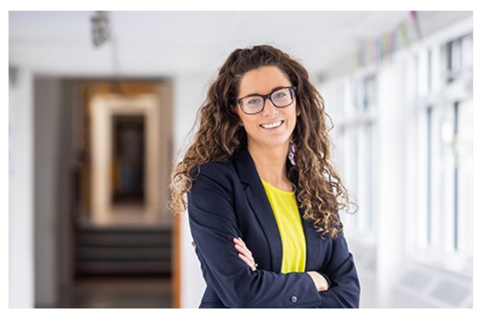
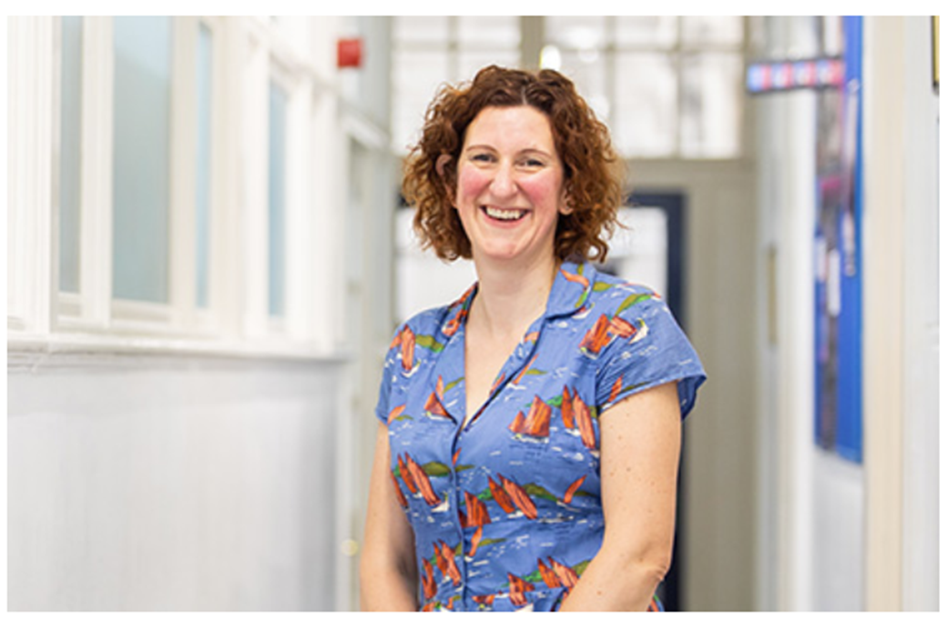
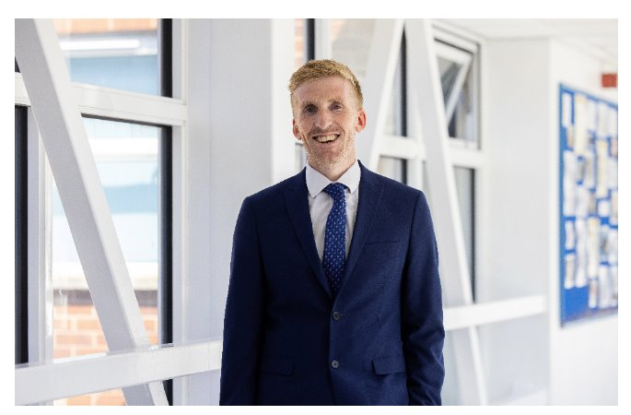
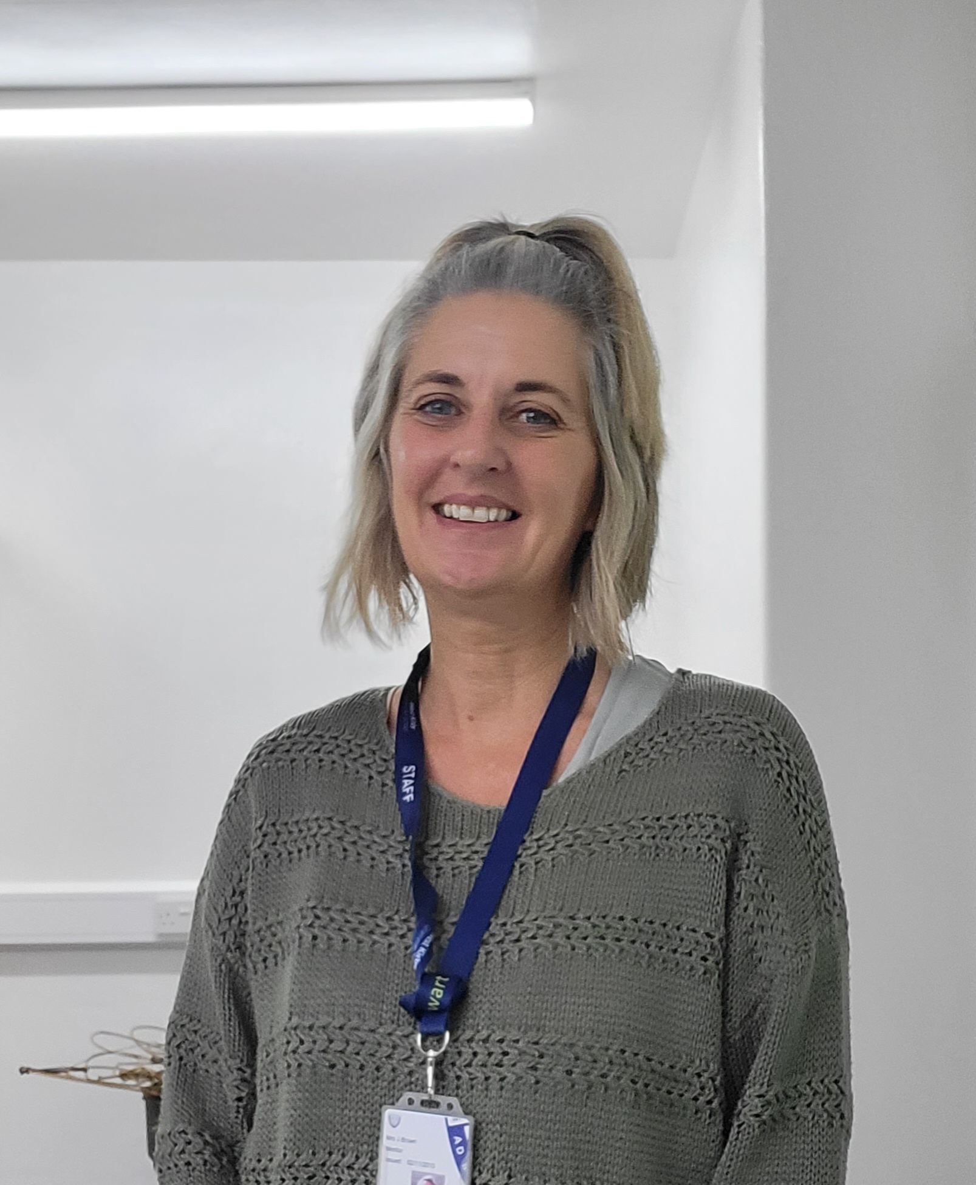
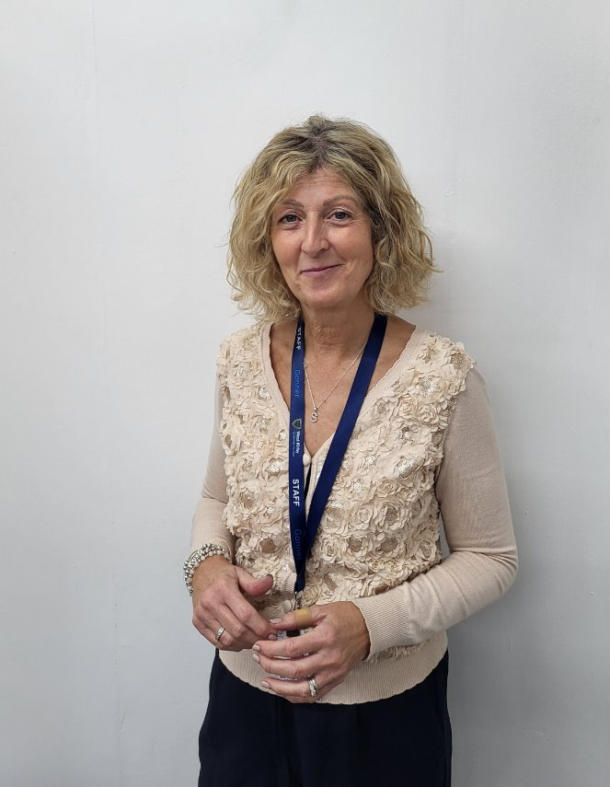
Mrs Marley - Assistant Head (Sixth Form)
Mrs Duffey – Head of Year 12
Mr Price – Head of Year 13​
Jenny Brown–Sixth Form Pastoral Assistant
Mrs Harris Smith – Sixth Form admin and DofE Co - Ordinator​

Slide 4
Additional Staff
Assistant Headteacher (Safeguarding & SEND Co-ordinator) –
Mrs Ravenwood
Assistant Headteacher (personal development/careers) - Mrs K Kimber
Well-Being Manager/SEND - Mrs D Lidgett
Examinations Officer - Mrs J Diamond
Attendance Officer – Mrs J Holland

Slide 5
Sixth Form Vision

Slide 6
Empowering Future Leaders
West Kirby Sixth Form is strong foundation for our students' future ambitions, fostering independence, resilience, and readiness for life beyond school. We want to equip all students with the skills to thrive in higher education and professional life, offering Year 12 students a transitional phase that bridges the structured support of previous years with the autonomy required for success.
We encourage students to embrace the challenges of the modern world, broadening their horizons and engaging with the concept of global citizenship. Through innovative teaching, reflective practice, and tailored guidance, students develop the confidence to pursue their goals with passion and purpose. Our aim is to inspire students not only to excel academically but also to grow as proactive, forward-thinking individuals who are ready to make meaningful contributions to their communities and the world.

Slide 7
A Nurturing and Connected Community
Our Sixth Form is a vibrant and supportive community where students thrive both as individuals and as part of a collective. Acting as role models and mentors, students take an active role in nurturing and inspiring younger students, sharing their experiences to help others overcome challenges and achieve their best.
This culture of mutual respect and empathy helps students deepen their understanding of themselves and their capacity to make a difference. At the same time, we provide a space where wellbeing, personal growth, and emotional resilience are prioritised. By fostering this compassionate environment, we ensure every student feels a strong sense of belonging, supported, and prepared for the opportunities and challenges that lie ahead.

Slide 8
Expectations

Slide 9
Expectations
Uniform
Attendance
Punctuality
Respect
Role models
Work ethic
Notes:
As a result of our aim to develop the individual, we must have HIGH expectations and these are:

Slide 10
Sixth Form Dress Code
Not Appropriate for School
Hoodies
Jeans
Shorts
Tracksuit bottoms
Leggings
Tight fitting or short skirts
Tops with large logos
Strappy tops
Flip flops
Trainers (or similar)/Canvas shoes/Uggs
Tailored trousers or skirt (appropriate in length and worn with tights)
Tops and shirts should be smart
Leather or leather effect shoes
Lanyard
Natural hair colour
Notes:
We want our Sixth Form students to feel different to the rest of the school so opt for a business wear dress code. We want students to dress for success!

Slide 11
Attendance and Punctuality
•Good attendance and punctuality is crucial for academic success. Attendance and punctuality in Sixth Form will be carefully monitored and attendance should not fall below 95%.
Information on this is often requested by universities and employers.
• Registration takes place 8.50am to 9.10am in the morning and 12.50pm to 12.55pm in the afternoon – in form rooms
• Students should arrive in the form room before the start time – otherwise sign in at reception on arrival to school.
• Lateness is monitored and appropriate staff will follow up.

Slide 12
ABSENCE PROCEDURE
Unforeseen absences
Parent/guardian/ward to contact school by telephone or e-mail (attendance@wkgs.net) on each day of absence, explaining the reason for the absence.
Medical and dental appointments
Students should complete the online form prior to appointments. Evidence of the appointment should be attached.
Other planned absence
Leave of absence form should be completed on and sent to attendance@wkgs.net in advance for Head Teacher's approval.
NOTE: Absences will be recorded as unauthorised until the appropriate paperwork is complete and returned.

Slide 13
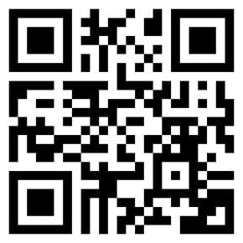
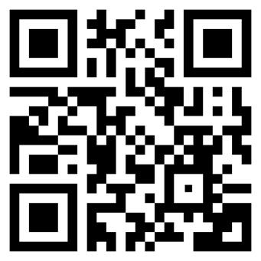
Medical Appointment Absences 25-26 – MUST upload evidence (appointments should be made outside of ALL timetabled lessons)
West Kirby Grammar School - Leave of Absence Form – for all absences other than medical appointments

Slide 14
Work Ethic
Use of lesson time and subject staff
Attendance at support sessions
Free lessons – used wisely reduces work time at home
Going the extra mile – super curricular
Minimum of 3 hours independent study per day
Supervised study - not for homework
Notes:
We have a number of designated sixth form study areas:
G5 - where Y12 do their supervised study – this is to promote and support independent study, essential for success at A-level. Our Sixth Form Pastoral assistant (Jen Brown) is based here and she also offers study and organisational support to those who need it,

Slide 15
MANAGING THE WORKLOAD

Slide 16
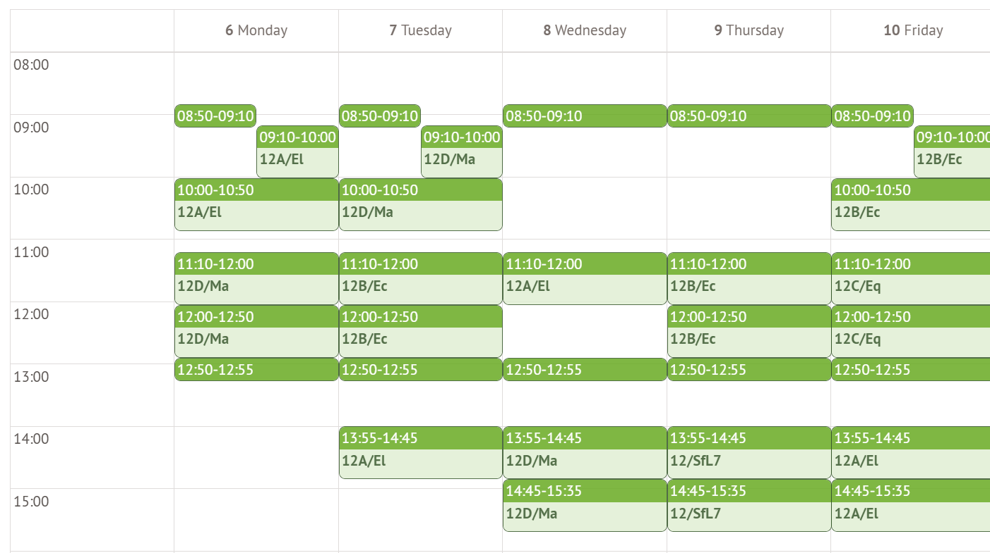

Slide 17
Study Timetables
What?
When?
Sport
What?
When?
Social
What?
When?
Hobbies
What?
When?
TV
What?
When?
Job

Slide 18
Hierarchy of Motivation
Fully
Motivated
Goal
Clarity
Largely Motivated
www.ucas.com
Flat liners
www.notgoingtouni.co.uk
Unmotivated

Slide 19
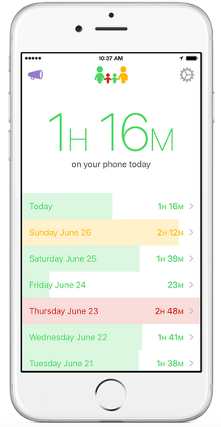
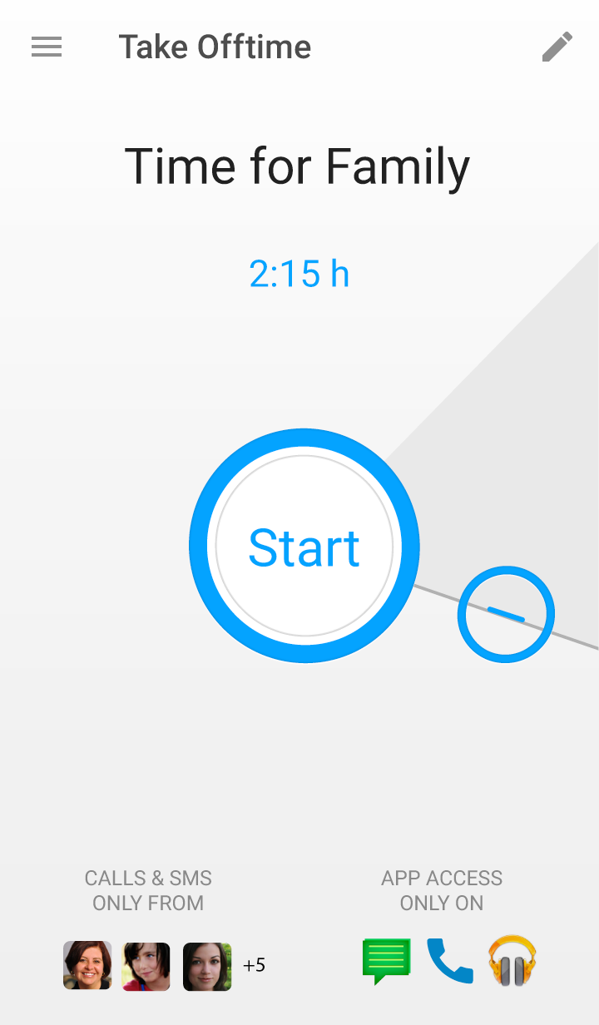
Dealing with Technology
Controlling behaviour → self-regulating behaviour

Slide 20
Sixth Form Progress Monitoring
Transition work/ Assessment
Ongoing monitoring by subject staff
Short report issued and action plans – once per term
AS Decisions (15th Dec)
Progress Evening (16th April)
End of year exams (WB 15th June)
Notes:
Students are monitored throughout Sixth Form and intervention put in place as required, in liaison with students, parents and staff.
Y12 complete transition work to help identify if chosen subjects are appropriate – right for them. We are a grammar school and want to push our students to achieve as highly as possible and want them to strive for the best.
Parents can access reports online and HOY reviews data and intervention such as increased supervised study, extra subject support, after school work clinic, sitting in on AS lessons, dropping subjects are put in place as appropriate.

Slide 21
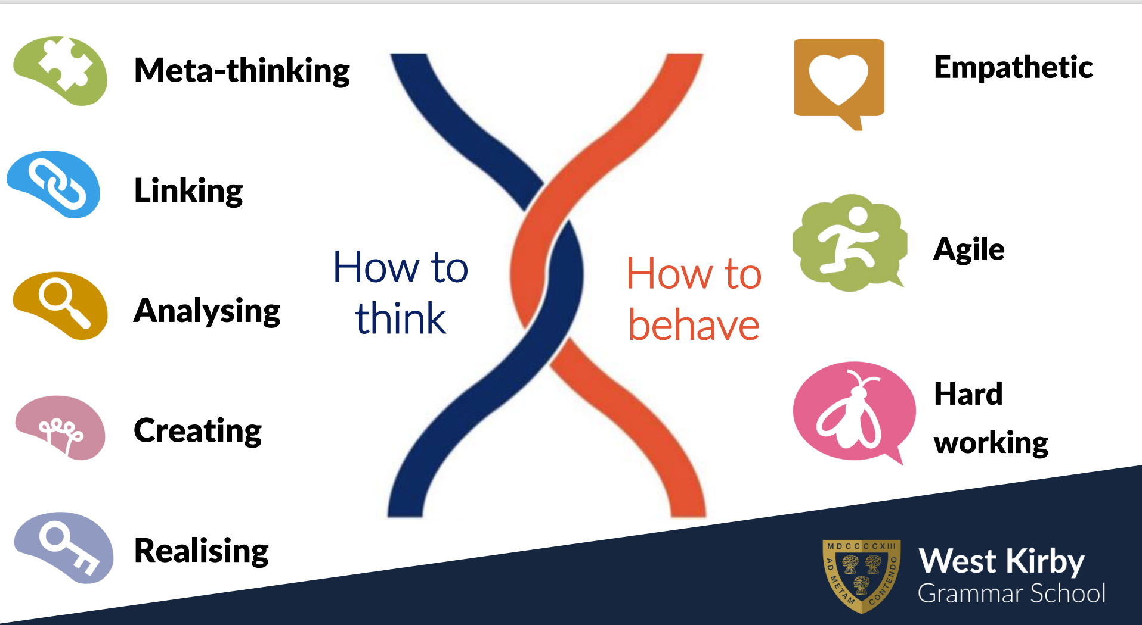
Notes:
Whole school

Slide 22
OPPORTUNITIES

Slide 23
Roles of Responsibility
Form Representatives
Charity Representatives
School Council – eco, charity, well-being & diversity and inclusion
Subject Mentors
Prefect Teams
Head Prefect Team
House Officials
Shaping Futures
Clubs & Societies
Trips/workshops
House activities
SLA
Notes:
We pride ourselves on the opportunities provided for students in Sixth Form
We have a head prefect team of 10 – including head boy/girl/s, deputies and senior prefects.
They lead a team of about 50 prefects (and other reps) – and take responsibility for certain areas across school:
KS3, KS4 and KS5 ambassadors, charity, global citizens, interform – where they work with students across the school and take a leading role.
Our House system is largely run but student officials – House captains and their team of house prefects. They organise and lead events.
Sixth Form students take a leading role in the whole school council and in many students take on roles as subject mentors for lower students.
Many Sixth form students run clubs and societies such as debate, creative writing, medic (and dentist) society, knitting, LGBTQ+, robotics, chess, rubics cube – to name some past and present.
SLA – student leadership award – students do this during form time in Y12 – see form time slide.
There is a wide variety of additional activities students can get involved with outside of lessons – trips, workshops, competitions which they can do independently or are lead within subjects departments – builds transferable skills
They are role models.

Slide 24
Form time
Week | W/B | Monday | TUESDAY | WEDNESDAY | FRIDAY
1 | 1st September | INSET | Induction Design a society? | Sixth form Assembly (whats your goal)/Admin/ WKGS way/ Nick- Cadets police | Making the best start in Year 12
2 | 8th September | MH Assembly (Welcome Back) | Democracy | Introduction to 5 ways of Wellbeing: | Importance of Y12 - foundation for Y13
3 | 15th September | 11+ INSET | Medical ethics | Introduction to Connection – | GCSE to A level understanding your subjects
4 | 22nd September | Year Assembly | World heart day/restart a heart | Connection: Common Ground Bingo | The benefits of extra- curricular activities
5 | 29th September | MH Assembly (Learning at WKGS) | Food waste awareness/world hunger | Connection: Would you rather? | Independent Learning
6 | 6th October | MH Assembly (Beh & rewards) | Black History Month | Connection: Never have I ever! | Mindset
7 | 13th October | Year Assembly (Intro to SLA) | 1:1/ SLA planning- use booklets | 1:1/ SLA planning | 1:1/ SLA planning
8 | 20th October | MH Assembly (Student Leadership) | Presentation skills Planning for next 7 Tuesday Activities | 1:1/SLA Planning | 1:1/SLA Planning
Notes:
There are 9 form groups in 6th form so groups are small – around 20 students – helps students settle in quickly. All students are mixed in new groups so new students feel part of the community from day one.
Students have year assembly and main hall assembly each week and house assembly each fortnight – students complete House tasks when not in house assembly.
For the other 2 mornings, there is a structured programme in place (will send separately for more context):
one morning per week students cover social, moral and religious views – they do short tasks and it is largely based around discussion of given questions. The topics fit in with the calendar of key globally recognised days (eg on slide – world mental health day)
On the second morning, they do activities/tasks based on year group and time of year –
Y12 focus on transition from GCSE and A-level and Y12 to Y13 and independent study. They also complete a student leadership award where they get accredited by SSAT for the skill they have developed through enrichment/extracurricular activities.
Y13 mainly focus on well being and mindset, as well as thinking to the future.
Tutors also use this time to carry out 1:1 interviews with students at certain times of the year – early in sept for Y12 to discuss settling in, then mainly following assessments to discuss progress.

Slide 25
Personal Development Day/RSE
Drugs and alcohol awareness
Further education choices, pathways and preparation for beyond Sixth Form
Revision, study skills and time management in Sixth Form
Basic first aid
Mental Health and Wellbeing
Driving and road safety
Respectful relationships, consent, sexual health
Notes:
As well as being part of the form programme – personal development for both Y12 and 13 is delivered via drop down days and is age specific.
Students cover topics such as:
Sexual health/harassment/consent/Relationships
Driving safety
Drugs and alcohol
First aid
Careers/Dreams and Goals
Global citizens/Projects work – eg enterprise challenge
Politics/voting
Money matter/finances
Looking after mental and physical health
Celebrating difference
This is delivered via staff or external providers as appropriate
We review this programme regularly to ensure we cover any subject areas relevant to the times.

Slide 26
Skills for Life
6 activities on rotation - 4 weeks each:
Cooking- Food for thought
Personal Development
Well-Being
Self Defence
Budgeting & Finance
Your Future
Notes:
Students have an afternoon a week of enrichment in both Y12 and 13. The activities are all based around the 5 ways to well being (connect, be active, keep learning, give, take notice) as it’s a chance for students to step away from the academics and develop skills in other areas. The blocks on slide are Y12 and Y13 is less structured.
Students are blocked based on the house they are in and select activities based on the theme of the block. These are either lead by staff or external providers we pay to deliver sessions. These can vary year to year. In Y13 the students lead some of the activities (usually those with coaching qualifications)
Examples of exercise activities (both years) – self-defence, football skills, walking, running, dance, fitness, using local gym, tennis, netball, cricket, basket ball
Community project is were student work in groups on a problem they are passionate about to work towards improving this and making a difference – this is to encourage students to be excellent global citizens. Examples include: raising awareness of period poverty, collecting books for primary schools, reducing food waste, reaching out to residents in carehomes
Well being examples – gardening, cooking/baking, arts and crafts, mindfulness colouring, yoga, walking
New skills – students can use this time to complete on line courses using open university or moocs, or photography, first aid. We also sometimes do in house first aid courses and predriving. Students can also do driving lessons in this block, sign language, different sports and music options
Some students also opt for one of the alternative activities which don’t fit in one of the blocks:
TEFL (teaching English as a foreign language), bar mock (students take part in the bar mock trail competition where they get to take on the various roles within the court while studying given cases. They get to attend the law courts and interact with experienced barristers), young reporters scheme (write articles for a newspaper which are published online), volunteering (students volunteer in primary schools, care homes, charity shops etc). Students who study subjects with a maths element who have not achieved a grade 6 also do Maths for A-level
Summer programme – see careers slide and programme for more info. Y13 have the first half term to complete ucas applications, prepare for admissions tests/interviews, apply for apprenticeships etc.

Slide 27

WKGS Sixth Form
Character 360° Journal

Slide 28
Why It Matters
Sixth Form is not just about getting great A-level grades, more importantly it is to help students discover who they are and who they want to be, as well as to develop the skills needed to get there.
Employers and universities will be looking for students to demonstrate a range of skills – the achievement journal is a powerful tool to showcase all skills developed and how.

Slide 29
1. Connect – Build relationships and foster community
Activity | Details | Date/s
Peer mentoring (study skills, pastoral or subject specific)
Set up/run club or society
Regularly attend a club/society
Lead a tutor group activity
Get a part time job (up to 10hrs/week)
Organise a whole school event
Participate in whole school event (eg school production, carol service)
Volunteer (eg care home, charity shop, sports club)
Lead/take part in a house activity
Hold sports leader role
Become a DofE younger leader
Active participation in CCF

Slide 30
Extended Project Qualification (EPQ)
Provides key skills that universities and employers are interested in
Independent learning – choice of topic and format (dissertation, investigation or fieldwork, production or artefact )
Exercise use of in-depth research and critical analysis
Additional qualification with UCAS points
Notes:
All students taking 3 A-levels will also do EPQ. This gives students an excellent opportunity to gain experience with independent research, critical analysis, reflection and referencing sources, academic writing and presentation skills. These are skills required for university (skills that often aren’t taught at this level so gives students a head start) – many universities will give a lower offer based on students having EPQ or it can set students aside from others on their personal statements. Students can select any topic so can be something they are interested in or linked to future aspirations.
Students have a double lesson a week for EPQ all have a supervisor to support the full process.

Slide 31
Part-time employment
We recognise the importance of employment; building skills, gaining experience, interaction with others, developing confidence and earning income.
Research nationally has shown that working up to 9 hours per week does not appear to influence examination grades
However, if employment exceeds 9 hours per week, research has shown that grades are lower for additional hours.
Social Time
Notes:
We encourage students to be independent and recognise having a part time job and earning their owe money forms part of this. It also helps students develop transferable skills which is important for their next steps. However, we encourage working hours to be kept to a minimum to ensure they can balance of academic studies and extracurricular activities.

Slide 32
SUPPORT

Slide 33
Form Staff
Form | Name/s | Contact
12W | Mr M Woods | mwoods@wkgs.net
12S | Mrs J Langford | jlangford@wkgs.net
12T | Mr N Armstrong | narmstrong@wkgs.net
12K | Mrs J Richards | jrichards@wkgs.net
12B | Mrs L Hughes/ Miss R Jolly | lhughes@wkgs.net & rjolly@wkgs.net
12Y | Mrs J Terry/ Mrs L McConcehy | jterry & lmcconechy@wkgs.net

Slide 34
Sixth Form Team
Name | Email
Mrs L Marley - Assistant Head Teacher: Sixth Form | lmarley@wkgs.net
Mrs A Duffey – Head of Year 12 | aduffey@wkgs.net
Mr R Price - Head of Year 13 | rprice@wkgs.net
Mrs J Brown – Pastoral Assistant | jbrown@wkgs.net
Mrs S Harris Smith – Admin/DofE | sharris@wkgs.net

Slide 35
Specialised Support
Name | Email
Mrs G Ravenwood –Assistant Headteacher: Safeguarding/SEND | gravenwood@wkgs.net
Mrs D Lidgett – Well-Being/SEND | dlidgett@wkgs.net
Mrs K Kimber – Assistant Headteacher: Personal Development/Careers) | kkimber@wkgs.net
Examinations Officer - Mrs J Diamond | jdiamond@wkgs.net

Slide 36

Careers Guidance
Dedicated Careers Library for Sixth Form
Careers advisor
Summer Programme
UCAS application support
Interview preparation support
Work experience week in summer term

Slide 37
Financial Support
Vulnerable Student Bursary – Up to £1200
- Care leavers
  - Students in receipt of income support
  Disabled students who receive Employment Support Allowance and Personal Independence Payments (Disability Living Allowance)
Discretionary Bursary - Up to £1000 per year
Household income less than £27,500
Notes:
Students apply for this and if eligible, financial support is offered for transport, in school meals, sixth form supplies and a contribution for uniform.

Slide 38
Parental Support/Communication
School communication to parents through Newsletter, Arbor and Edulink to:
- monitor attendance, behaviour and participation
- messages/reminders about events
Communication from parents to school through email via subject staff/tutors/HOY
Joining Sixth Form | West Kirby Grammar School

Slide 39
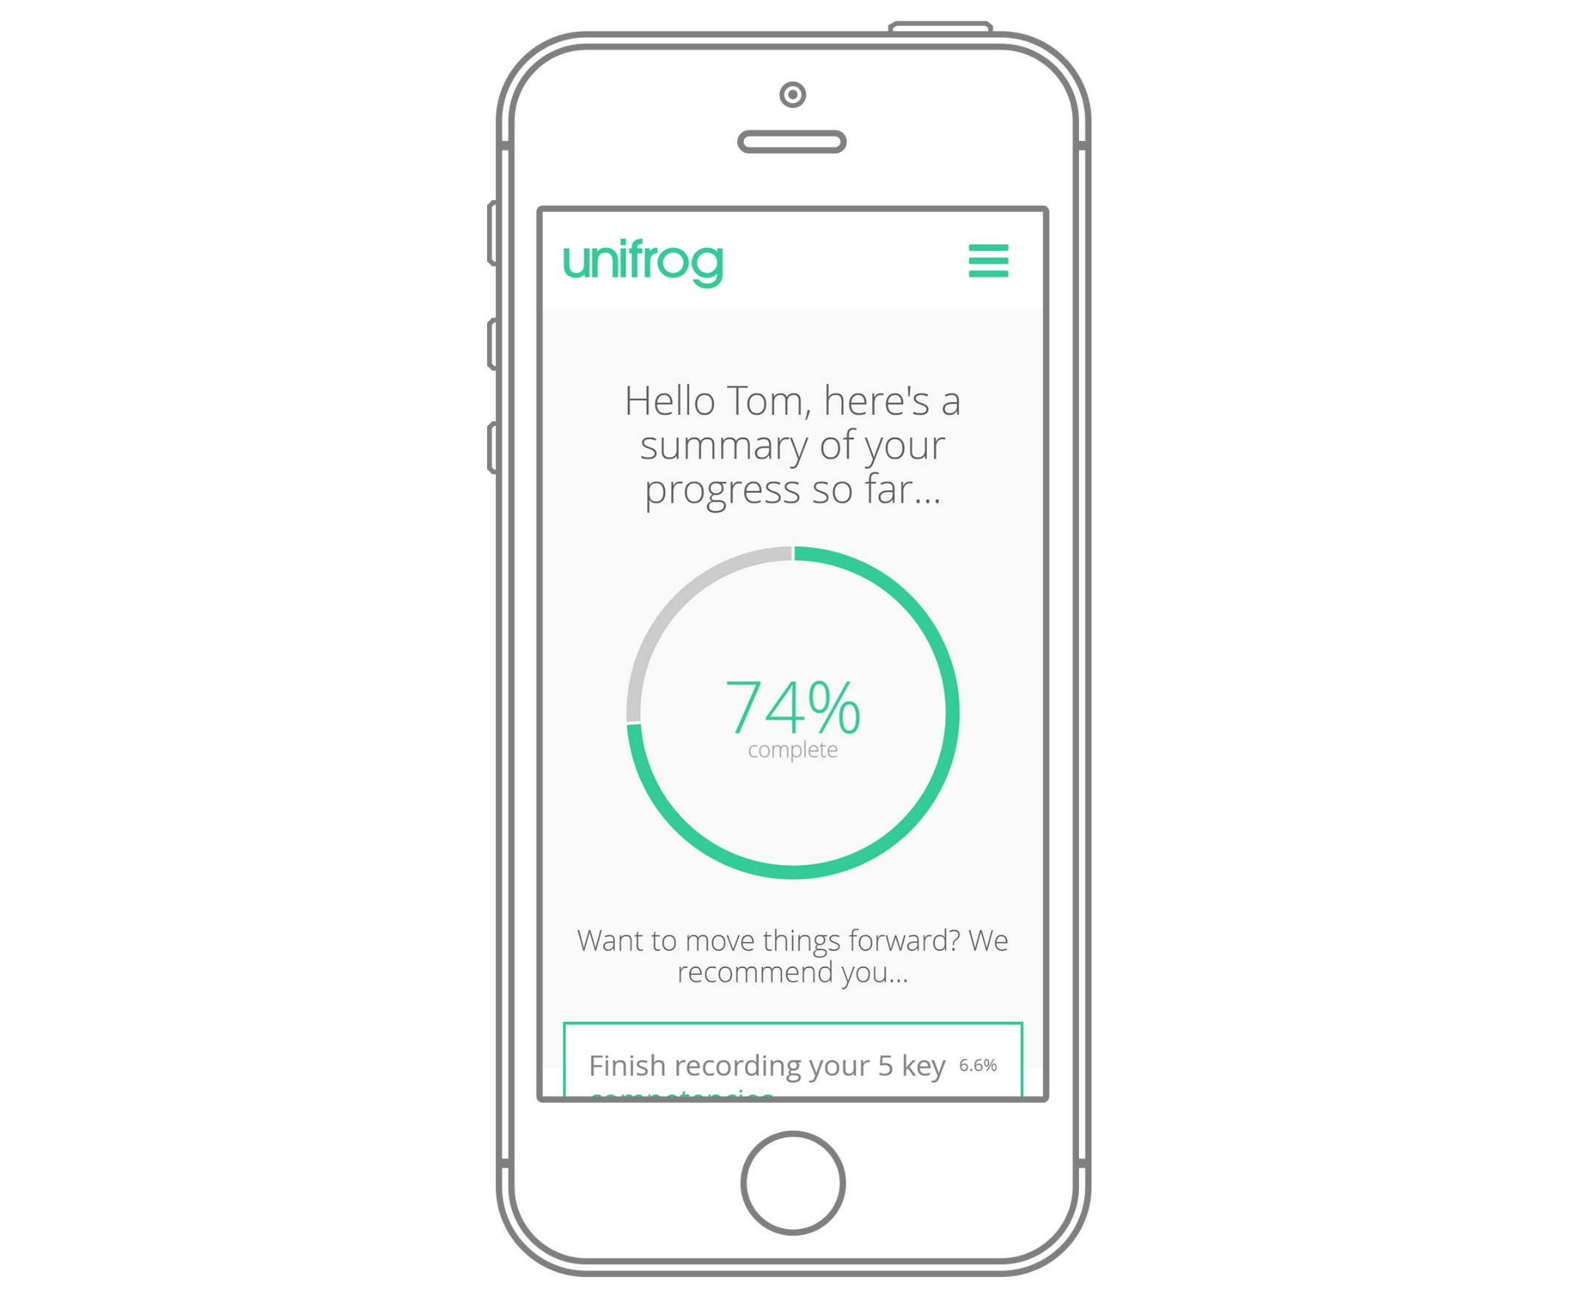
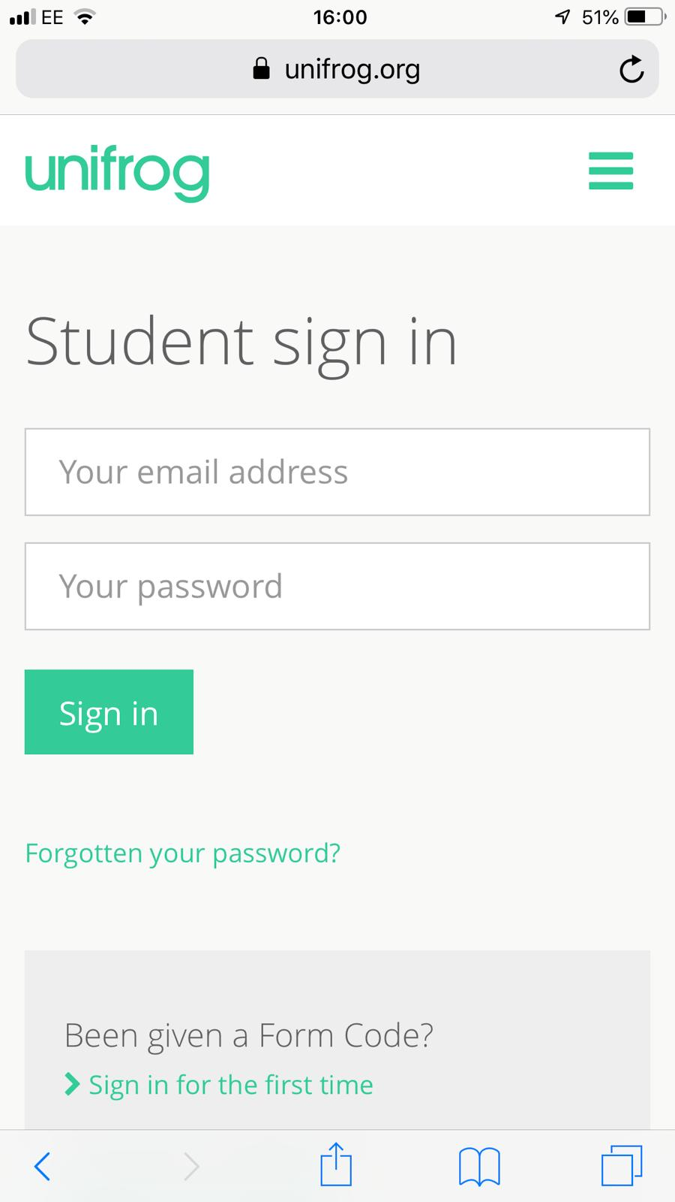
Parents & guardians, get signed up!
Go to www.unifrog.org/student and click ‘Sign in for the first time’
You’ll be asked for some details and a form code. This is what you need:
WKGSparents
After signing up, log into Unifrog using your email address and password via the student sign-in page.

